Slide 1

NLP Project
Sentiment Analysis
Project

Slide 2
Team Members:
1- Mohammed Atallah
2-Mahmoud Abo Elnaga
3- Seif
4-Salma Elghanam
5-Menna Elsayed
6-Fatma

Slide 3

Content :
1- Dataset definition and link
2- Our problem
3-Data cleaning and preprocessing
4-EDA
4- Models
5-Deployment

Slide 4

Dataset:
The dataset contains customer reviews in Arabic, collected from various companies and products. It includes key features such as review text, sentiment ratings (positive or negative), and the company associated with the review. This dataset is ideal for Natural Language Processing (NLP) tasks, such as sentiment analysis, text classification, and topic modeling, specifically for Arabic text.
Link: https://www.kaggle.com/datasets/mohamedramadan2040/arabic-customer-reviews

Slide 5

Our problem:
The problem of sentiment analysis in this dataset involves classifying Arabic text into sentiment categories (positive, negative, or neutral). It requires handling challenges such as the Arabic language's complexity, imbalanced data, and the need for thorough text preprocessing. By applying appropriate machine learning models, sentiment can be extracted from these reviews to understand customer feedback.

Slide 6
Data cleaning
Drop missing and duplicated values
Ignore neutral values
Balancing Positive and Negative Ratings in a Dataset

Slide 7
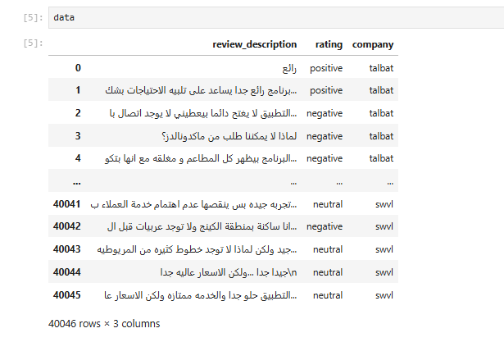
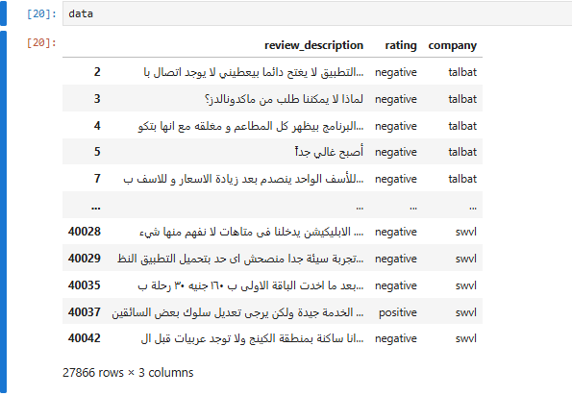
Data before cleaning
Data after cleaning

Slide 8
Text Preprocessing
Replacing Emojis and Emoticons with Descriptive Text:
Emojis and emoticons are replaced with descriptive Arabic words to normalize text for analysis. This is done using dictionaries and a function applied to the dataset column. This improves consistency and model performance.
Tokenization :
Splits text into smaller units (tokens) for easier processing in NLP tasks using nltk’s word_tokenize function.
Removing stop words and rejoin the text again :
removes common Arabic stop words from a list of tokens (words) in a dataset and filters out predefined stop words (like "لا", "ليس", etc.) from the list and rejoin the cleaned tokens into text.

Slide 9
.Normalization:
-Removing diacritics, numbers, and punctuation:
-Standardizing variations of Arabic letters (e.g., Alef, Taa Marbuta, Yaa, Waw with Hamza, and Hamza):
standardizes Arabic text by replacing different forms of letters (such as Alif, Taa Marbuta, Yaa, Waw with Hamza, and Hamza) with their consistent forms, ensuring uniformity and reducing variations in the text.
-Eliminating repeated characters and extra whitespaces:
This step eliminates repeated characters (e.g., "اا" becomes "ا") and extra whitespaces (ensuring only one space between words and removing leading/trailing spaces) to standardize the text.
-Removing non-Arabic characters (e.g., Latin letters):
removes any non-Arabic characters (including Latin letters, punctuation, and other symbols), keeping only Arabic letters (from the Unicode range ء-ي) and spaces.
THIS STEP REMOVES ARABIC DIACRITICAL MARKS (SUCH AS VOWELS OR OTHER MARKS LIKE FATHA, DAMMA, KASRA) BY USING THE UNICODE RANGE \U064B-\U065F, WHICH CORRESPONDS TO ARABIC DIACRITICAL SYMBOLS. REMOVING DIACRITICS HELPS STANDARDIZE THE TEXT BY ELIMINATING UNNECESSARY MARKS.

Slide 10
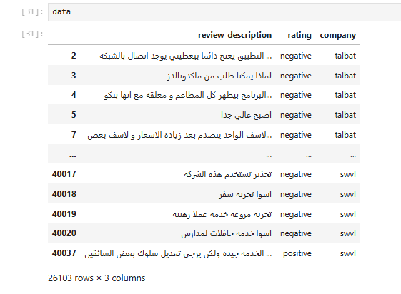
Data after text preprocessing

Slide 11
EDA

Slide 12
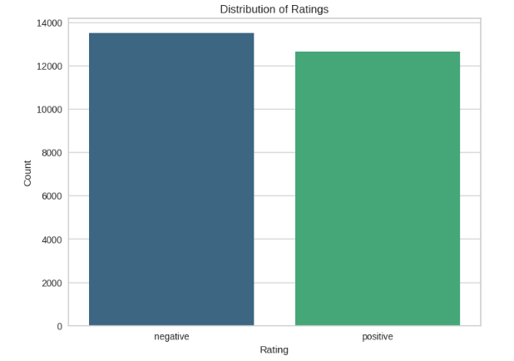
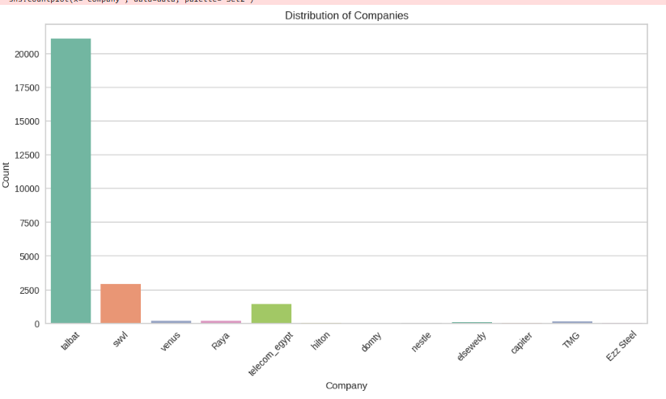
Interpretation:
The chart suggests that negative ratings are more prevalent than positive ratings, with a noticeable difference in their counts, indicating a stronger presence of dissatisfaction compared to satisfaction among the ratings.
Interpretation:
This chart indicates a highly uneven distribution of companies across the different categories, with one category(Talabat) significantly outnumbering the others. It suggests that most companies fall within the dominant category, while others are relatively scarce. This could point to a concentration of firms in a particular sector or industry.

Slide 13
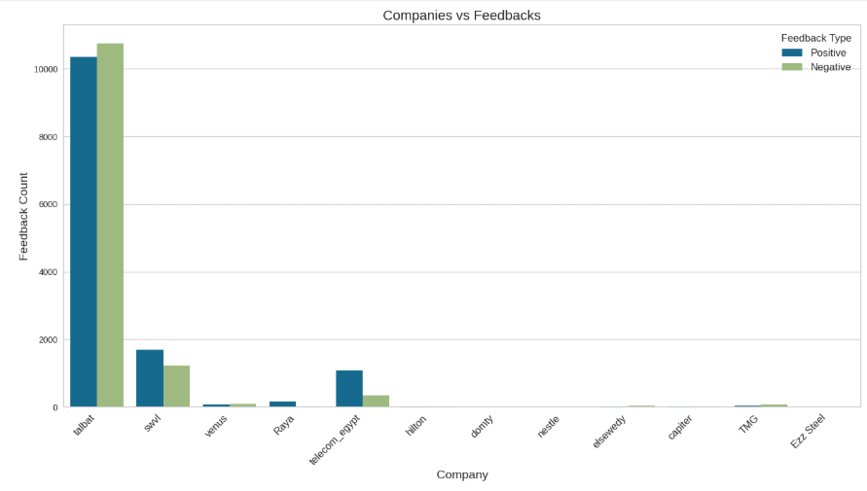
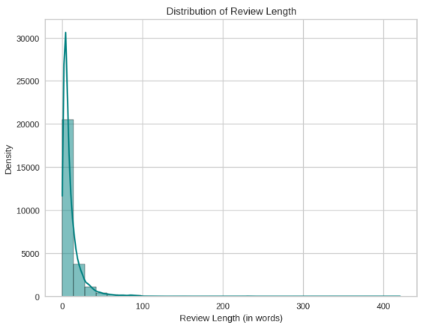
Interpretation:
This chart illustrates a concerning trend where several companies receive substantially more negative feedback than positive feedback. The disparity highlights potential dissatisfaction among customers or users for most companies, with one company particularly standing out for its high negative feedback count.
Interpretation:
This histogram indicates that most reviews are concise, typically under 100 words, while longer reviews are rare. This could imply that users prefer to write brief comments rather than detailed accounts, or it might reflect the nature of the feedback being given.

Slide 14
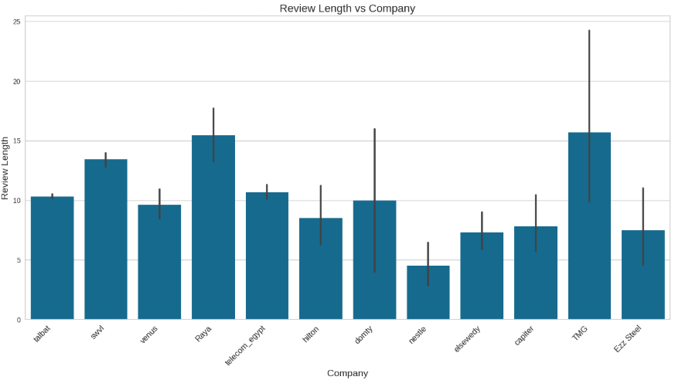
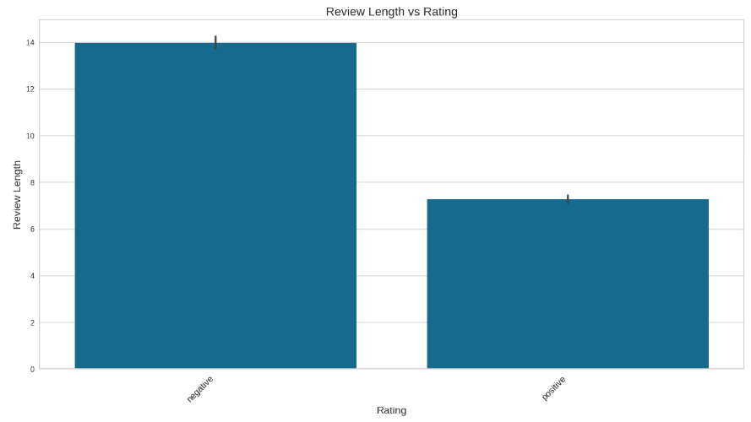
Interpretation:
This chart suggests that users tend to provide more detailed feedback when they give negative ratings, likely reflecting a desire to explain their dissatisfaction. In contrast, positive reviews are generally shorter, which could imply that users are more satisfied and feel less need to elaborate.
Interpretation:
This bar chart provides insight into user feedback behavior across different companies, suggesting that certain companies elicit more detailed responses from their users while others receive more concise feedback.

Slide 15
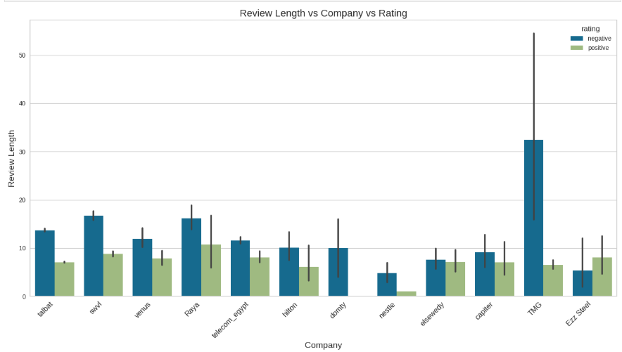
Interpretation: This chart illustrates how user feedback varies across different companies based on their ratings. The tendency for negative reviews to be longer suggests that customers feel more compelled to elaborate on their negative experiences. The variability indicated by the error bars highlights differences in how customers express their opinions across different companies, with "TMG" being a notable case for extended feedback.

Slide 16
Before training the models on the data, the following steps are performed:
The textual ratings ('positive' and 'negative') are mapped to numerical values
(1 and -1, respectively).
The original rating column is dropped from the dataset.
The review_description column is assigned as features (X),while the rating_numeric
column is assigned as labels (y).
The text data is vectorized using TfidfVectorizer, converting the text into numerical form.
The vectorized data is stored in a sparse DataFrame for efficient processing.
These steps prepare the dataset for model training.

Slide 17
Models :
1-logistic regression
2-naïve bayes
3-Random Forest
4-support vector machine (linear SVC)

Slide 18
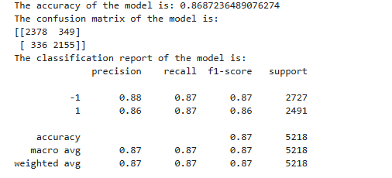
Logistic regression
Logistic Regression trains by adjusting weights to find a decision boundary that separates classes. It uses a logistic function to predict probabilities and minimizes errors through optimization, with regularization to prevent overfitting. The model is trained on the training data, and its performance is evaluated on both training and test datasets using specified parameters and the `evaluate_model` function.

Slide 19
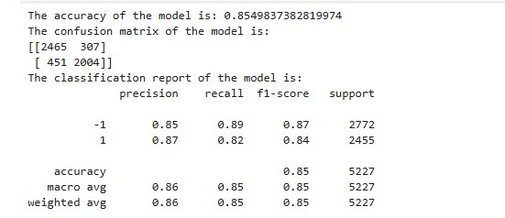
Naïve bayes
Naive Bayes trains by estimating the probability of each class based on the feature distributions. It applies Bayes' theorem with the assumption of feature independence, calculating the likelihood of each class given the features. The model uses the training data to learn the class probabilities and feature distributions, with regularization helping to manage overfitting. After training, the model’s performance is evaluated on both the training and test datasets using the specified parameters and the evaluate_model function.

Slide 20
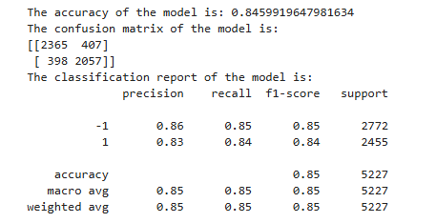
Random forest
Random Forest trains by constructing multiple decision trees, each trained on a random subset of the data. It uses an ensemble learning technique to combine the predictions of individual trees for improved accuracy. Each tree predicts a class, and the class with the majority vote becomes the final prediction. The model is trained on the training data, and its performance is evaluated on both the training and test datasets using specified parameters and the `evaluate_model` function, with regularization techniques to prevent overfitting and enhance generalization.

Slide 21
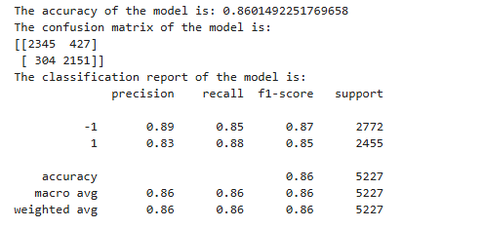
support vector machine (linear SVC)
The SVC model (Support Vector Classifier) trains by finding the optimal hyperplane that best separates classes in the feature space. It uses a linear kernel to classify data points and minimizes errors through optimization. Regularization is applied to control the margin width and prevent overfitting. The model is trained using the training data, and the optimal parameters are found using `GridSearchCV`, which performs an exhaustive search over a parameter grid. After training, the model’s best parameters and accuracy are printed. The performance of the SVC model is evaluated using the specified parameters and cross-validation (CV).

Slide 22
Deployment using Streamlit:
deploying a Logistic Regression model with Streamlit:
first, we train the model on our dataset and save it using `joblib`.
Next,we create a Streamlit app by loading the saved model and building a user-friendly web interface where users can input data for predictions.
The app will dynamically display the prediction results as users interact with the input fields.
Streamlit’s `st.number_input` is used for collecting feature values, and `st.button` triggers the prediction process. Once the app is ready, deploy it on platforms such as Streamlit Cloud or Heroku, ensuring that a `requirements.txt` file is included to list all necessary dependencies.

Slide 23


Thank you
A heartfelt thank you to our head, Mohammed Atwan, for the immense dedication and hard work he has shown in guiding and supporting us throughout this journey. His efforts have been invaluable, and we truly appreciate the leadership and commitment he demonstrated in helping us achieve our goals.

